Slide 1


Alfian Galih Akbar Prasetya
03/05/2024

Slide 2

Outline
Executive Summary
Introduction
Methodology
Results
Conclusion

Slide 3
Executive Summary
Summary of methodologies:
Data Collection through API
Data Collection with Web Scraping
Data Wrangling
Exploratory Data Analysis with SQL
Exploratory Data Analysis with Data Visualization
Interactive Visual Analytics with Folium
Machine Learning Prediction
Summary of all results:
Exploratory Data Analysis result
Interactive analytics in screenshots
Predictive Analytics result

Slide 4
Introduction
According to Space X’s advertisement on its website, the Falcon 9 rocket launches cost 62 million dollars while other providers cost upward of 165 million dollars each. These savings are because Space X reused the previous stage. If we can determine whether the first stage will land, we can predict the approximate cost of a launch. This information can be used for any alternate company that wants to compete Space X. Thus, the goal of this research is to create a machine-learning pipeline to predict if the first stage will land successfully.
Problems you want to find answers
What factors determine if the rocket will land successfully?
The interaction amongst various features that determine the success rate of a successful landing.
What operating conditions needs to be in place to ensure a successful landing program.

Slide 5

Section 1

Slide 6
Methodology
Executive Summary
Data collection methodology:
Data is collected from :
(https://api.spacexdata.com/v4/rockets/) and
from Wikipedia, using web scraping (https://en.wikipedia.org/wiki/List_of_Falcon/_9/_and_Falcon_Heavy_launches),
Perform data wrangling
by creating a landing outcome label based on outcome data after summarizing and analyzing features
Perform exploratory data analysis (EDA) using visualization and SQL
Perform interactive visual analytics using Folium and Plotly Dash
Perform predictive analysis using classification models

Slide 7
Data Collection
In the next slides, we will explain how we collect the data we use to do the research
Data is collected from :
(https://api.spacexdata.com/v4/rockets/) and
from Wikipedia (https://en.wikipedia.org/wiki/List_of_Falcon/_9/_and_Falcon_Heavy_launches),
using web scraping techniques.

Slide 8
Data Collection – SpaceX API
This is how data collection has been done in this project:
Request and parse the SpaceX launch data
Filter the data frame to only include Falcon 9 launches
Deal with the missing values

Slide 9
Data Collection - Scraping
This is how web scraping has been done in this project:
Request the Falcon9 Launch Wiki page from its URL
Extract all column/variable names from the HTML table header
Create a data frame by parsing the launch HTML tables

Slide 10
Data Wrangling
This is how data wrangling has been done in this project:
Calculate the number of launches on each site
Calculate the number and occurrence of each orbit
Calculate the number and occurence of mission outcome of the orbits

Slide 11
EDA with Data Visualization
In this project, we use scatterplots and bar plots to visualize the relationship between the followings pair of features:
Payload Mass vs. Flight Number
Flight Number vs. Launch Site
Payload Mass vs. Launch Site
Success Rate compared to each orbit
Add the GitHub URL of your completed EDA with data visualization notebook, as an external reference and peer-review purpose

Slide 12
EDA with SQL
These are the following SQL Queries we will perform in this project:
Display of unique launch site names in the space mission
Display of 5 records where launch sites begin with the string 'CCA’
Display of total payload mass carried by boosters launched by NASA (CRS)
Display of average payload mass carried by booster version F9 v1.1
The date when a ground pad's first successful landing outcome was achieved.
List of booster names that have success in drone ships and have payload mass greater than 4000 but less than 6000
List of total number successful and failed mission outcomes
List of booster version names which have carried the maximum payload mass. Use a subquery

Slide 13
EDA with SQL
These are the following SQL Queries we will perform in this project:
List of records which display the month names, failure landing outcomes in drone ship, booster versions, and launch site for the months in the year 2015.
Rank of landing outcomes counts (such as Failure (drone ship) or Success (ground pad)) between the date 2010-06-04 and 2017-03-20, in descending order.
Add the GitHub URL of your completed EDA with SQL notebook, as an external reference and peer-review purpose

Slide 14
Build an Interactive Map with Folium
These are map objects used in this project to show some information about launching sites:
Markers that indicate launch sites with captions
*to indicate whether launch sites are in proximity to the Equator line and whether launch sites are in very close proximity to the coast.
2. Marker clusters that indicate success/failed launch records for each site on the map
*to identify which launch sites have relatively high success rates.
3. Lines that calculate the distances between a launch site to its proximities
- To indicate whether launch sites are close to railways, highways, and coastline
- To indicate whether launch sites are keeping a certain distance away from cities

Slide 15
Build a Dashboard with Plotly Dash
These are available contents in the Plotly Dashboard for this research:
Pie charts showing the total launches by certain sites
A scatter graph showing the relationship between Outcome and Payload Mass (Kg) for the different booster versions.

Slide 16
Predictive Analysis (Classification)
Here is how predictive analysis has been done in this research:
Get the data loaded using Numpy and pandas, then transformed and split them into training and testing.
Build different machine learning models and tune with different hyperparameters using GridSearchCV.
Accuracy was used as the metric for the model, then it was improved using feature engineering and algorithm tuning.
The result is considered as the best-performing classification model for this research
Add the GitHub URL of your completed predictive analysis lab, as an external reference and peer-review purpose

Slide 17
Results
Here are the exploratory data analysis results we conclude:
Space X used 4 different launch sites to launch falcon 9;
The first launches were done by Space X itself and NASA;
The average payload of F9 v1.1 booster is 2,928 kg;
The first successful landing outcome happened in 2015, which was five year after the first launch;
Many Falcon 9 booster versions that were successful at landing in drone ships had payloads above the average;
Most of mission outcomes were successful;
There were failed landings in drone ships from two booster versions in 2015, which are: F9 v1.1 B1012 and F9 v1.1 B1015;
The performance of landing outcomes became as better each year.

Slide 18

Section 2

Slide 19
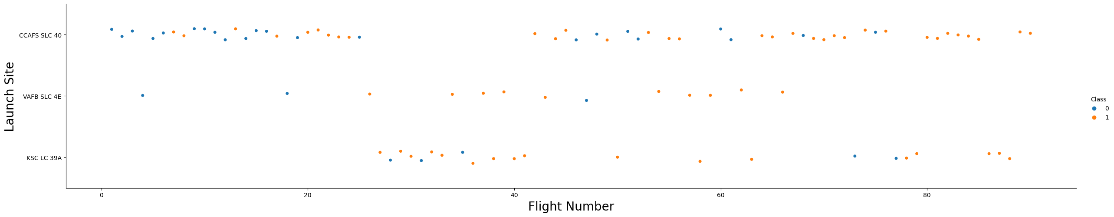
Flight Number vs. Launch Site
Here is a scatter plot that shows the total number of flight number of each launch site with additional information of the outcome of each launch (color)
The data shows that CCAFS SLC 40 is the most commonly used launch site in SPACEX
Success rate for each launch site will be shown later

Slide 20
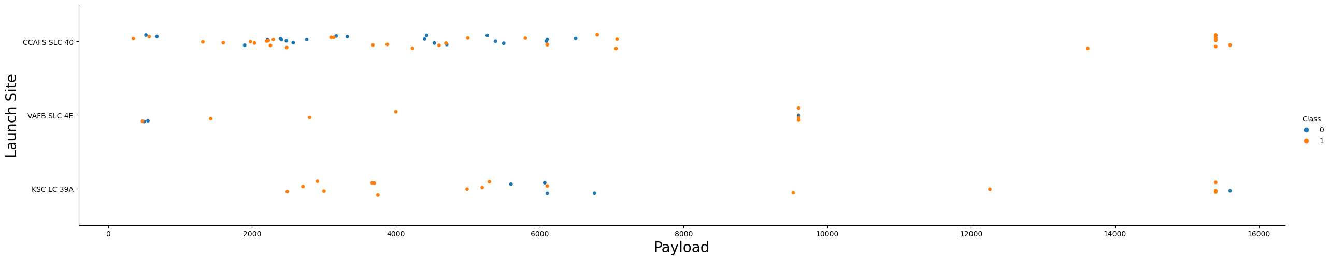
Payload vs. Launch Site
Here is a scatter plot that show a relationship between rocket’s payload mass and launch site with additional information of the outcome of each launch (color)
In the VAFB-SLC launch site there are no rockets launched for heavy pay load mass (greater than 10000).
Success rate for each launch site will be shown later

Slide 21
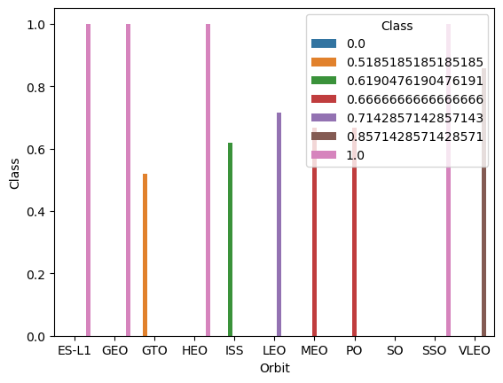
Success Rate vs. Orbit Type
Here we have a bar chart showing the success rate of each orbit type (with additional information of the success probability for each orbits).
It shows that orbit ES-L1, GEO, HEO, and SSO, each has 100% success rate on their launch.

Slide 22
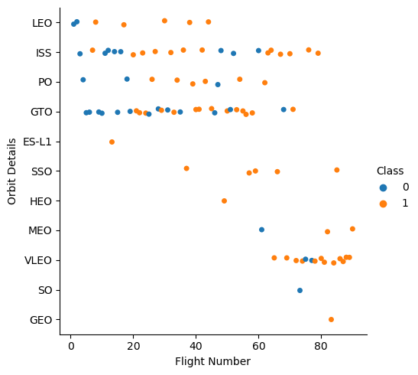
Flight Number vs. Orbit Type
Here we have a scatter point that shows relationship between flight numbers and Orbit types with additional information of the outcome of each launch (color).
in the LEO orbit the Success appears related to the number of flights; on the other hand, there seems to be no relationship between flight number when in GTO orbit.

Slide 23
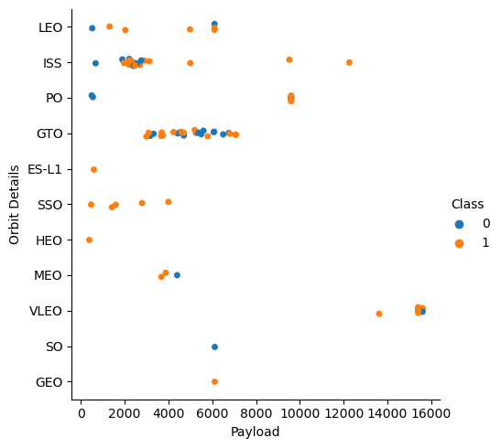
Payload vs. Orbit Type
This scatter point shows the relationship between payload mass and orbit types
With heavy payloads the successful landing or positive landing rate are more for Polar, LEO, and ISS.
However for GTO we cannot distinguish this well as both positive landing rate and negative landing (unsuccessful mission) are both there here.

Slide 24
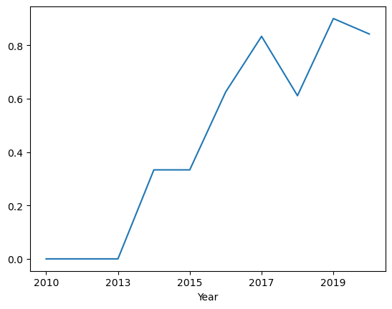
Launch Success Yearly Trend
This line chart shows yearly average launch success rate
We can observe that the success rate since 2013 kept increasing till 2017 (stable in 2014) and after 2015, it started increasing.

Slide 25
All Launch Site Names
There are four launch site names, which are:
Launch_Site
CCAFS LC-40
VAFB SLC-4E
KSC LC-39A
CCAFS SLC-40

Slide 26
Launch Site Names Begin with 'CCA'
Here are 5 examples of records where launch sites begin with `CCA`:
Launch_Site
CCAFS LC-40
CCAFS LC-40
CCAFS LC-40
CCAFS LC-40
CCAFS LC-40

Slide 27
Total Payload Mass
Here is the total payload carried by boosters from NASA:
SUM(PAYLOAD_MASS__KG_)
45596

Slide 28
Average Payload Mass by F9 v1.1
Here is the average payload mass carried by booster version F9 v1.1:
AVG(PAYLOAD_MASS__KG_)
2928.4

Slide 29
First Successful Ground Landing Date
According to the data, the first successful landing outcome on ground pad was on :
22 Desember 2015
MIN(DATE)
2015-12-22

Slide 30
Successful Drone Ship Landing with Payload between 4000 and 6000
Here is a list of boosters which have successfully landed on drone ship and had payload mass greater than 4000 but less than 6000:
Booster_Version
F9 FT B1022
F9 FT B1026
F9 FT B1021.2
F9 FT B1031.2

Slide 31
Total Number of Successful and Failure Mission Outcomes
Here is the total number of successful and failure mission outcomes:
Mission_Outcome | count(*)
Failure (in flight) | 1
Success | 99
Success (payload status unclear) | 1

Slide 32
Boosters Carried Maximum Payload
Here is a list the names of the booster which have carried the maximum payload mass:
Booster_Version
F9 B5 B1048.4
F9 B5 B1049.4
F9 B5 B1051.3
F9 B5 B1056.4
F9 B5 B1048.5
F9 B5 B1051.4
F9 B5 B1049.5
F9 B5 B1060.2
F9 B5 B1058.3
F9 B5 B1051.6
F9 B5 B1060.3
F9 B5 B1049.7

Slide 33
2015 Launch Records
Here is a list the failed landing outcomes in drone ship, their booster versions, and launch site names for in year 2015:
Month | Landing_Outcome | Booster_Version | Launch_Site
01 | Failure (drone ship) | F9 v1.1 B1012 | CCAFS LC-40
04 | Failure (drone ship) | F9 v1.1 B1015 | CCAFS LC-40

Slide 34
Rank Landing Outcomes Between 2010-06-04 and 2017-03-20
Here is a count summary of landing outcomes (such as Failure (drone ship) or Success (ground pad)) between the date 2010-06-04 and 2017-03-20, in descending order:
Landing_Outcome | Count
No attempt | 10
Success (drone ship) | 5
Failure (drone ship) | 5
Success (ground pad) | 3
Controlled (ocean) | 3
Uncontrolled (ocean) | 2
Failure (parachute) | 2
Precluded (drone ship) | 1

Slide 35

Section 3

Slide 36

launch sites’ location markers on a global map
SpaceX launch sites are in the USA in the coastline of Florida and California.

Slide 37
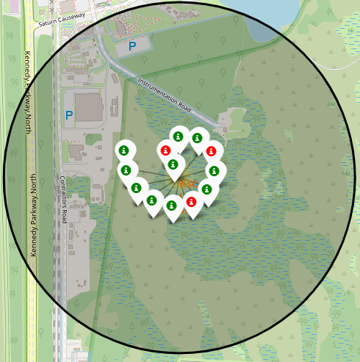
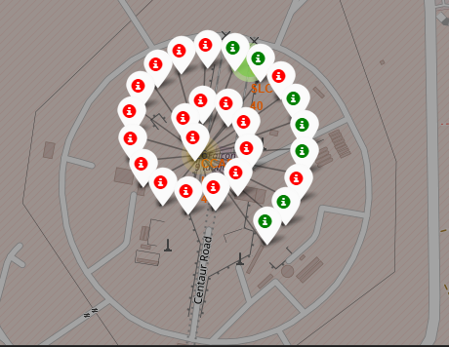
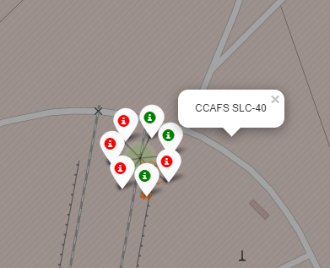
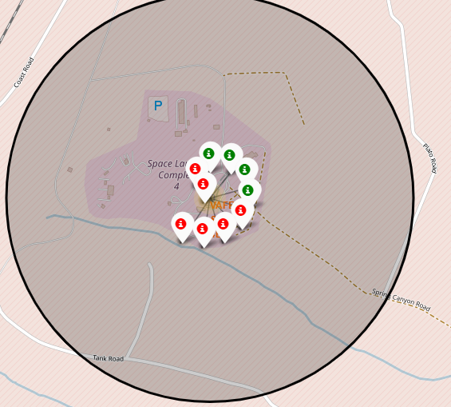
color-labeled launch outcomes on the map
Here are color-labeled launch outcomes from the launch site in Florida
Here are color-labeled launch outcomes from the launch site in California
KSC LC-39A | CCAFS LC-40 | CCAFS SLC-40 |  | VAFB SLC-4E

Slide 38
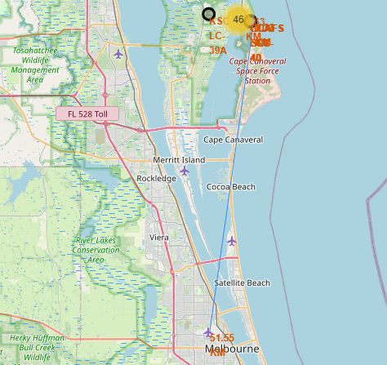
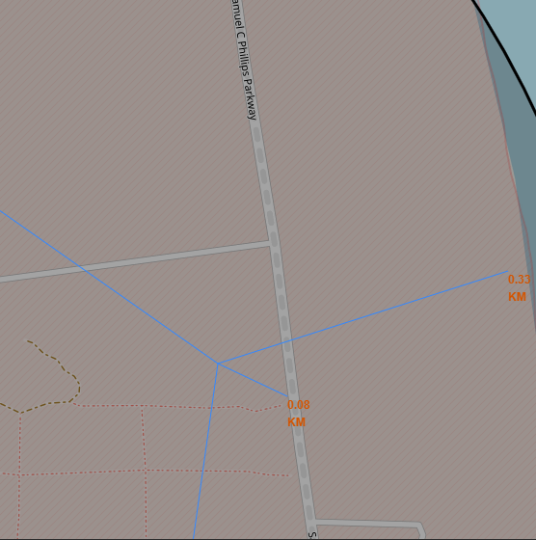
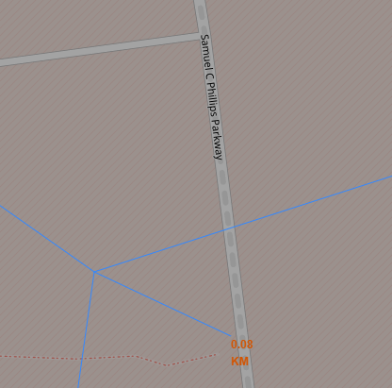
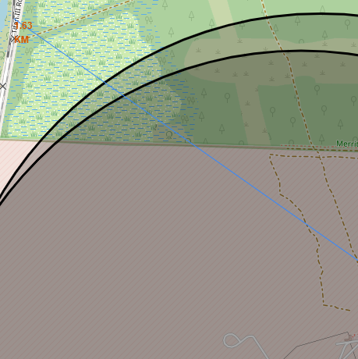
Ideal Sites for Launch Sites
These are ideal conditions for a launch site
Away from cities (51,55 km from Melbourne City, US) | Near a coastline (0,33 km from nearby coastline) | Near a highway (accessible highway, easy supply) | Accessible nearby railroad (easy supply)

Slide 39

Section 4

Slide 40
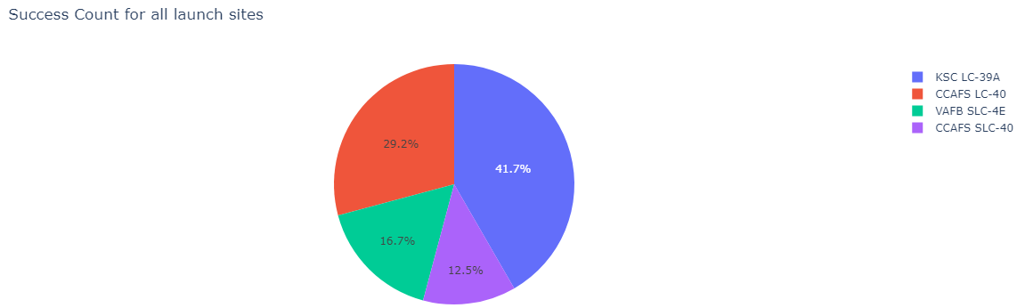
Success count for all launch site
This pie chart shows the percentage of total success count for all launch sites
Most successful launch came from KSL LC-39A Launch Site

Slide 41
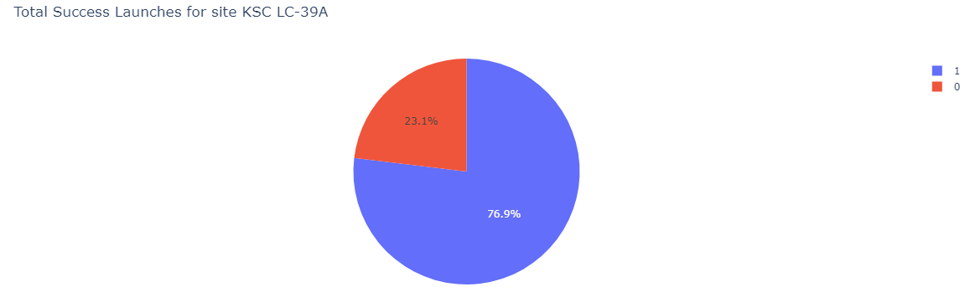
Total Success Launches for site KSC LC-39A
This pie chart shows a launch site with the highest launch success ratio (KSC LC 39A)
More than ¾ of its total launches are successful

Slide 42
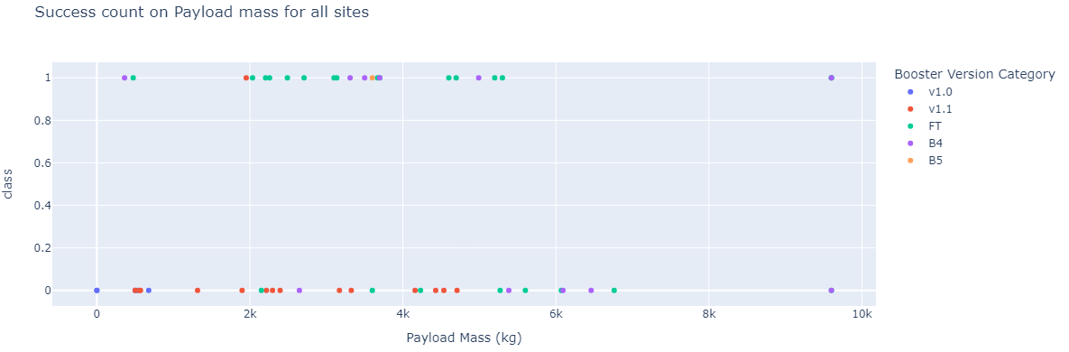
Success Count Compared with Payload Mass
We can see that most successes came from FT Booster version and the most successful launch’s payload mass ranged between 2k kg and 7k kg.

Slide 43

Section 5

Slide 44
Classification Accuracy
Visualize the built model accuracy for all built classification models, in a bar chart
Find which model has the highest classification accuracy

Slide 45
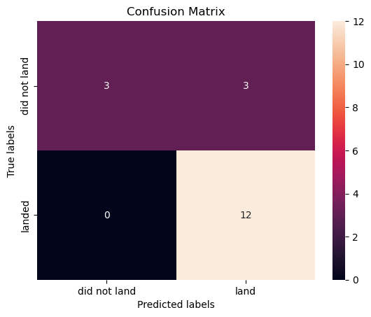
Confusion Matrix
Here is the confusion matrix of the best-performing model with an explanation which is KNN method
It shows that the classifier is able to distinguish between different classes.

Slide 46
Conclusions
From the research above, we can conclude that:
The larger the flight amount at a launch site, the better the success rate of a launch.
Launch success rate increased from 2013 to 2020.
Orbits ES-L1, GEO, HEO, SSO, and VLEO had the most success rate.
KSC LC-39A had the most successful launches compared to other launch sites.
The KNN Method is the best machine-learning algorithm for this research.

Slide 47


